Slide 1




SNIPSNAP
DECEMBER 5,2025
WSTL31C
SNIPSNAP
Style, Redefined. For Everyone.
NAME OF PROJECT:
PRESENTED BY:
PRESENTED TO:
SNIPSNAP
Marc Dave U. Ofilanda
Ma’am. Gen-Gen H. Roma

Slide 2


SYSTEM ARCHITECTURE

Slide 3
SYSTEM ARCHITECTURE
  Frontend: PHP templates + vanilla JS (modals, AJAX), CSS in style.css, shared header/footer in includes.
  Backend (App): Procedural PHP endpoints (e.g., handle_login.php, handle_signup.php, handle_booking.php, admin pages) using db_connect.php.
  Data Layer: MySQL via db_connect.php, using prepared statements (recommended), transactions for booking/payment flows.
  Auth & Sessions: PHP sessions; role-based redirects to customer_dashboard.php or admin pages.
  Payments: Handlers for paymongo, paypal, gcash/paymaya; verification endpoints and payout/refund flows.
  Background/Jobs: Admin scripts like admin_cleanup_old_pending.php, admin_process_payouts.php.
  Storage: Static assets in images, videos in videos, payment proofs uploads folder (check your handlers).
  Observability: Server logs, optional PHP error log; add simple request logging around payment verification for traceability.

Slide 4
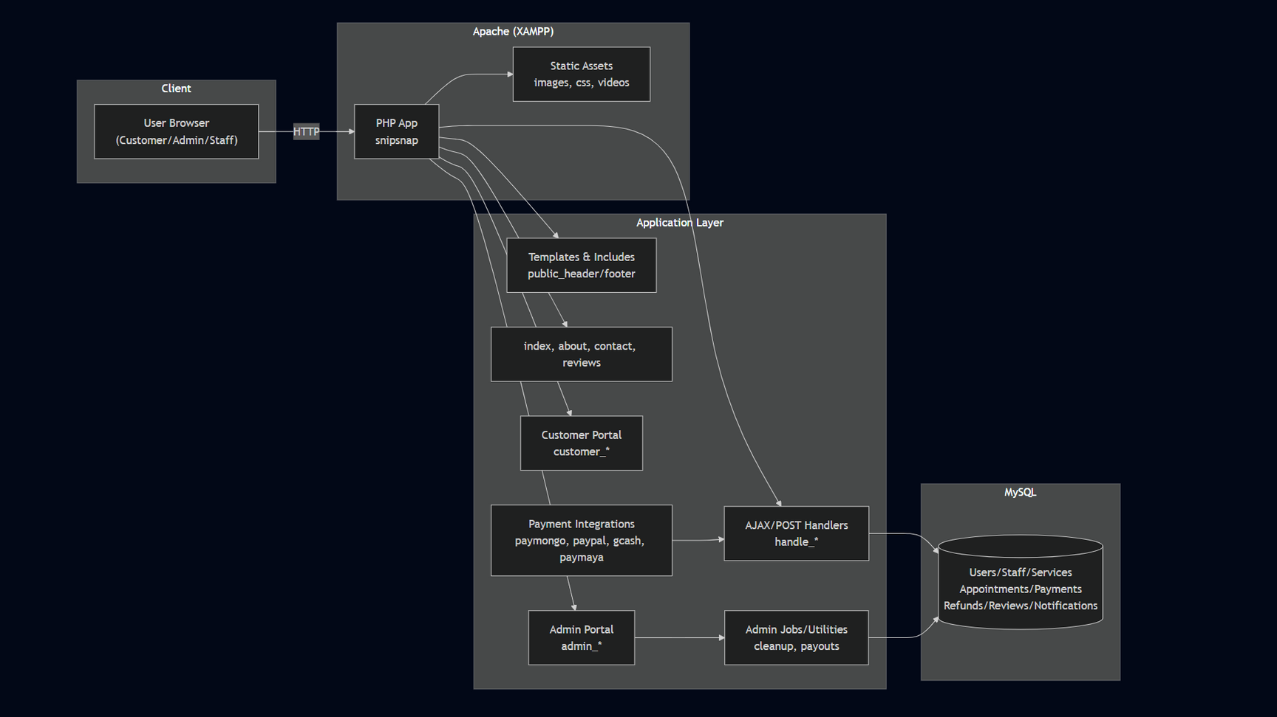
SYSTEM ARCHITECTURE

Slide 5
DATABASE DESIGN

Slide 6
DATABASE DESIGN
  users
    id PK, name, email UNIQUE, password_hash, phone, gender, role ENUM(customer,staff,admin), status ENUM(active,inactive), created_at, updated_at
  staff_profiles
    id PK, user_id FK users(id), bio, experience_years, specialties (JSON/text), rating_avg, rating_count
  services
    id PK, name, description, base_price, duration_minutes, category, is_active
  staff_services
    staff_id FK staff_profiles(id), service_id FK services(id), price_override NULL, duration_override NULL; PK(staff_id,service_id)
  availability
    id PK, staff_id FK, weekday TINYINT(0–6), start_time, end_time
  availability_overrides
    id PK, staff_id FK, date, is_available, start_time NULL, end_time NULL, note
  appointments
    id PK, customer_id FK users(id), staff_id FK, service_id FK, scheduled_at DATETIME, duration_minutes, price, status ENUM(pending,confirmed,in_progress,completed,cancelled,no_show,refunded), created_at, updated_at, cancelled_by ENUM(customer,staff,admin) NULL, cancel_reason NULL

Slide 7
DATABASE DESIGN
2nd Part
  payments
    id PK, appointment_id FK, method ENUM(paymongo,paypal,gcash,paymaya,cash), provider_txn_id, amount, currency, status ENUM(pending,authorized,paid,failed,refunded,chargeback), proof_url NULL, created_at, updated_at, verified_at NULL
  refunds
    id PK, payment_id FK, amount, reason, status ENUM(requested,approved,processed,rejected), processed_by FK users(id) NULL, created_at, updated_at
  payouts
    id PK, staff_id FK, period_start, period_end, gross_amount, platform_fee, net_amount, status ENUM(pending,processed,failed), created_at, processed_at NULL
  favorites
    customer_id FK, staff_id FK; PK(customer_id,staff_id)
  reviews
    id PK, appointment_id FK, customer_id FK, staff_id FK, rating INT(1–5), comment, created_at, is_published
  notifications
    id PK, user_id FK, type ENUM(booking,payment,refund,promo,system), title, message, data JSON, is_read, created_at
  notification_settings
    user_id FK, email_opt_in, sms_opt_in, push_opt_in; PK(user_id)

Slide 8
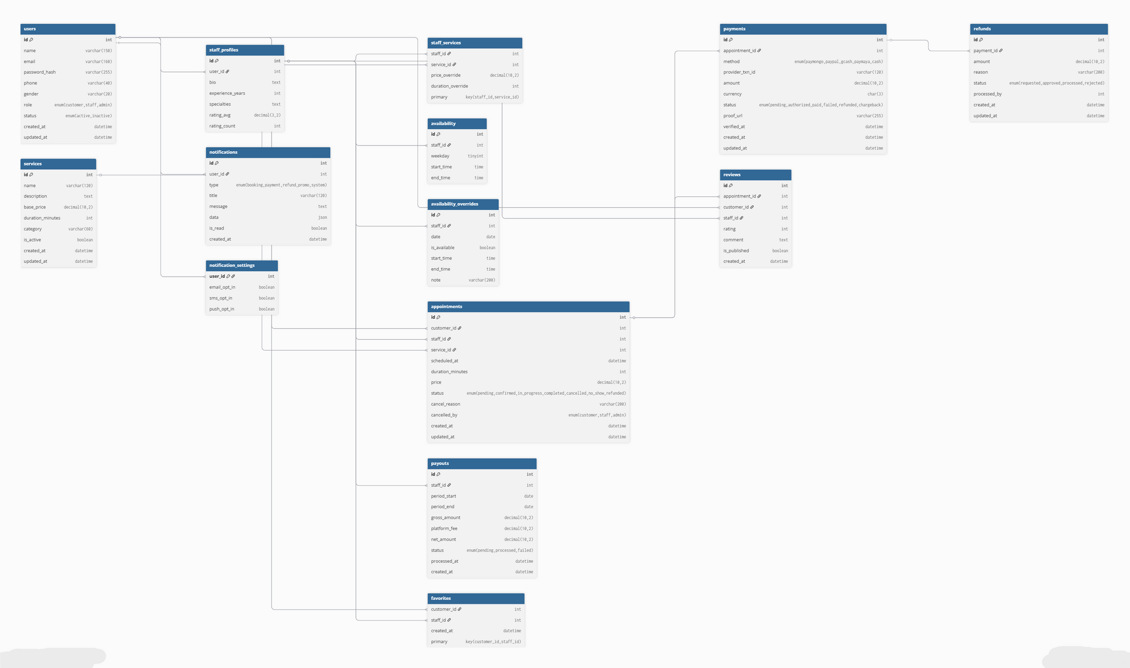
DATABASE DESIGN

Slide 9


Slide 10
STORYBOARD

Slide 11
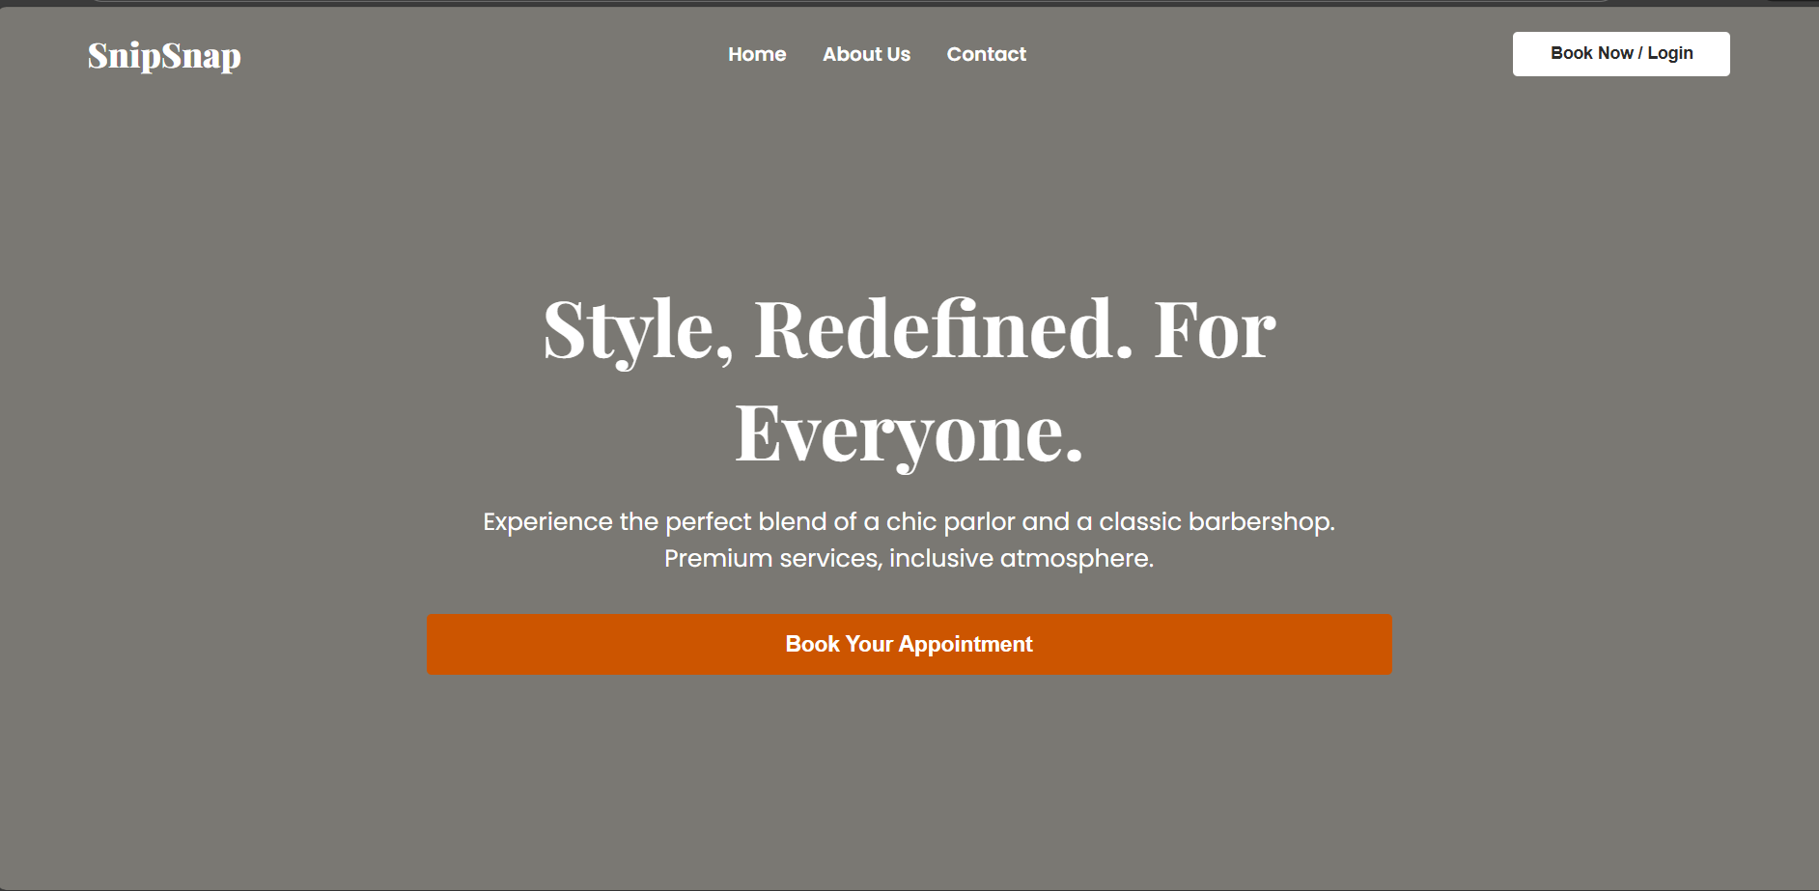
Front Page

Slide 12
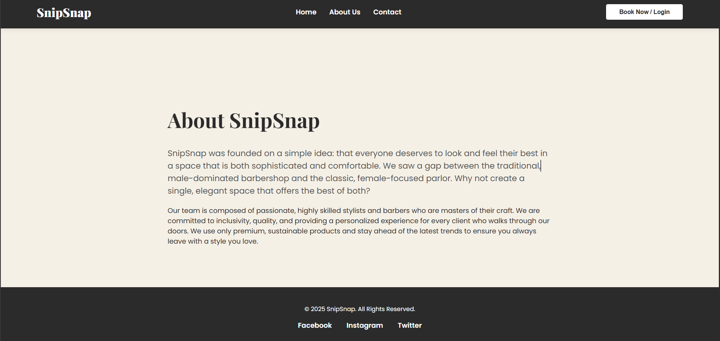
About Us Page

Slide 13
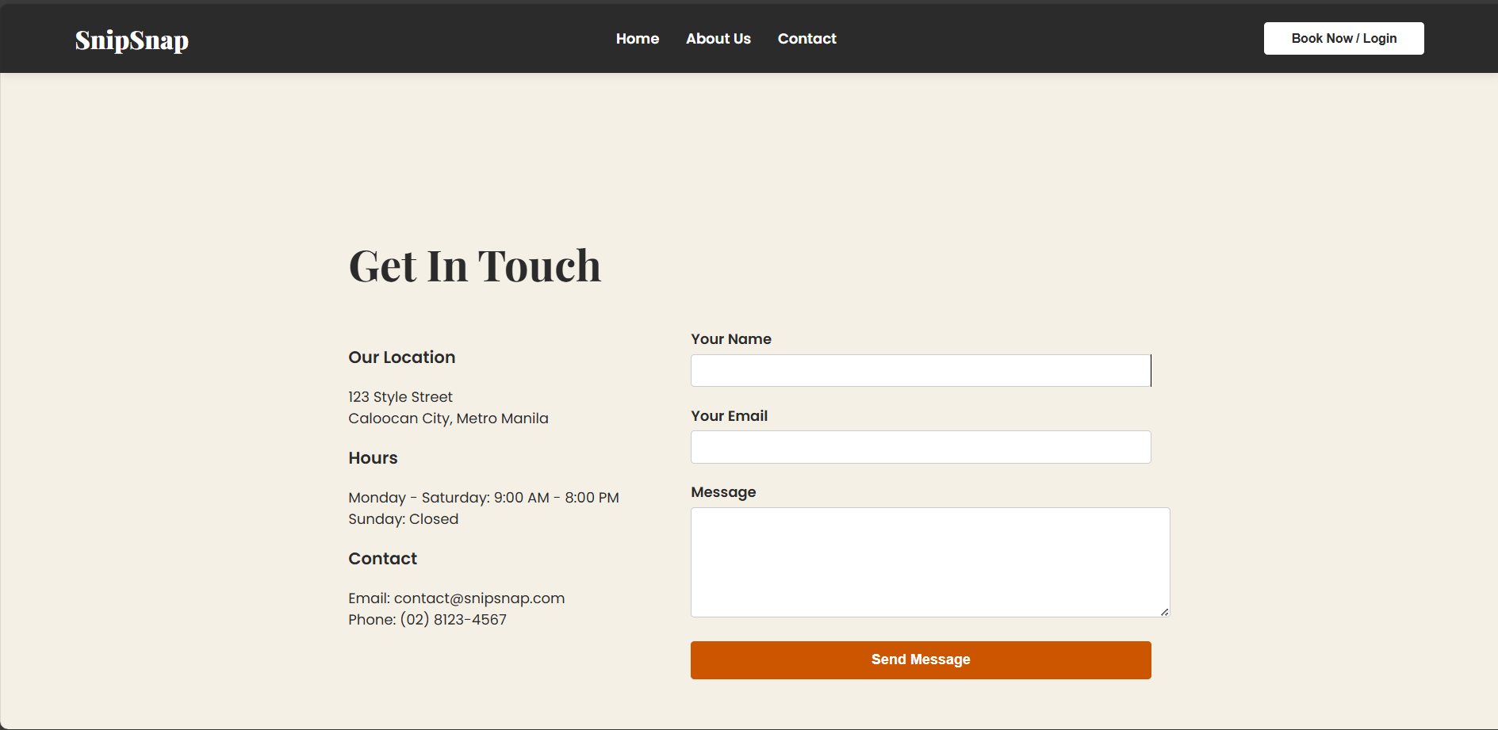
Contact Page

Slide 14
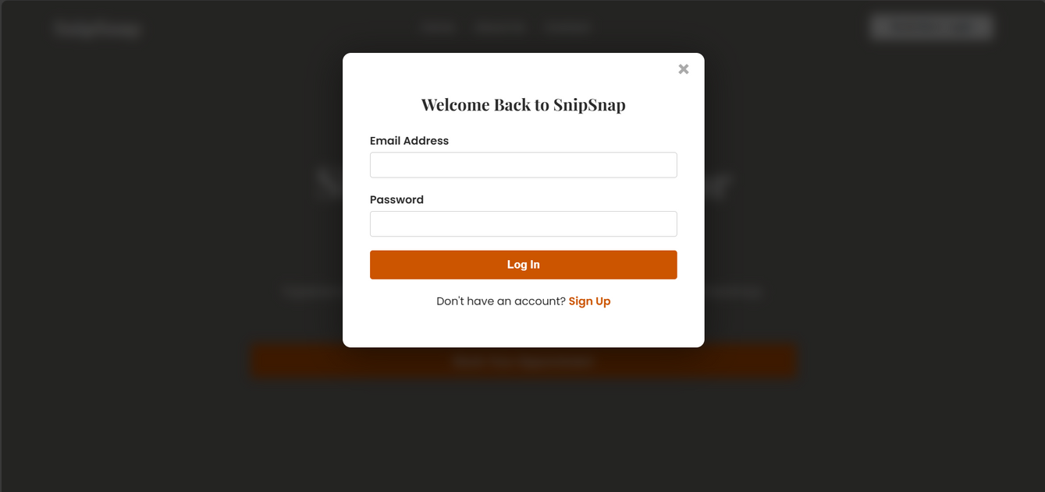
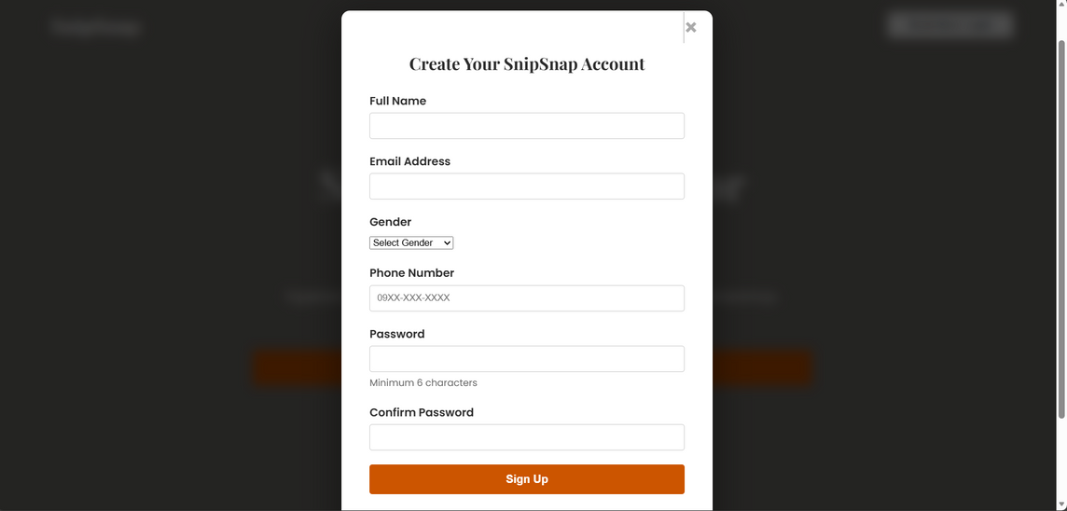
Login & Register Page

Slide 15
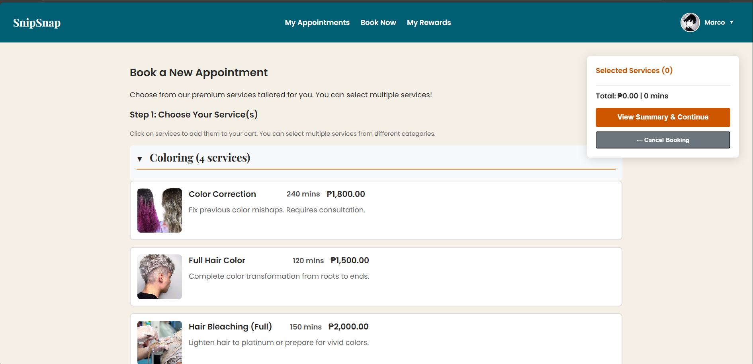
Booking Page

Slide 16
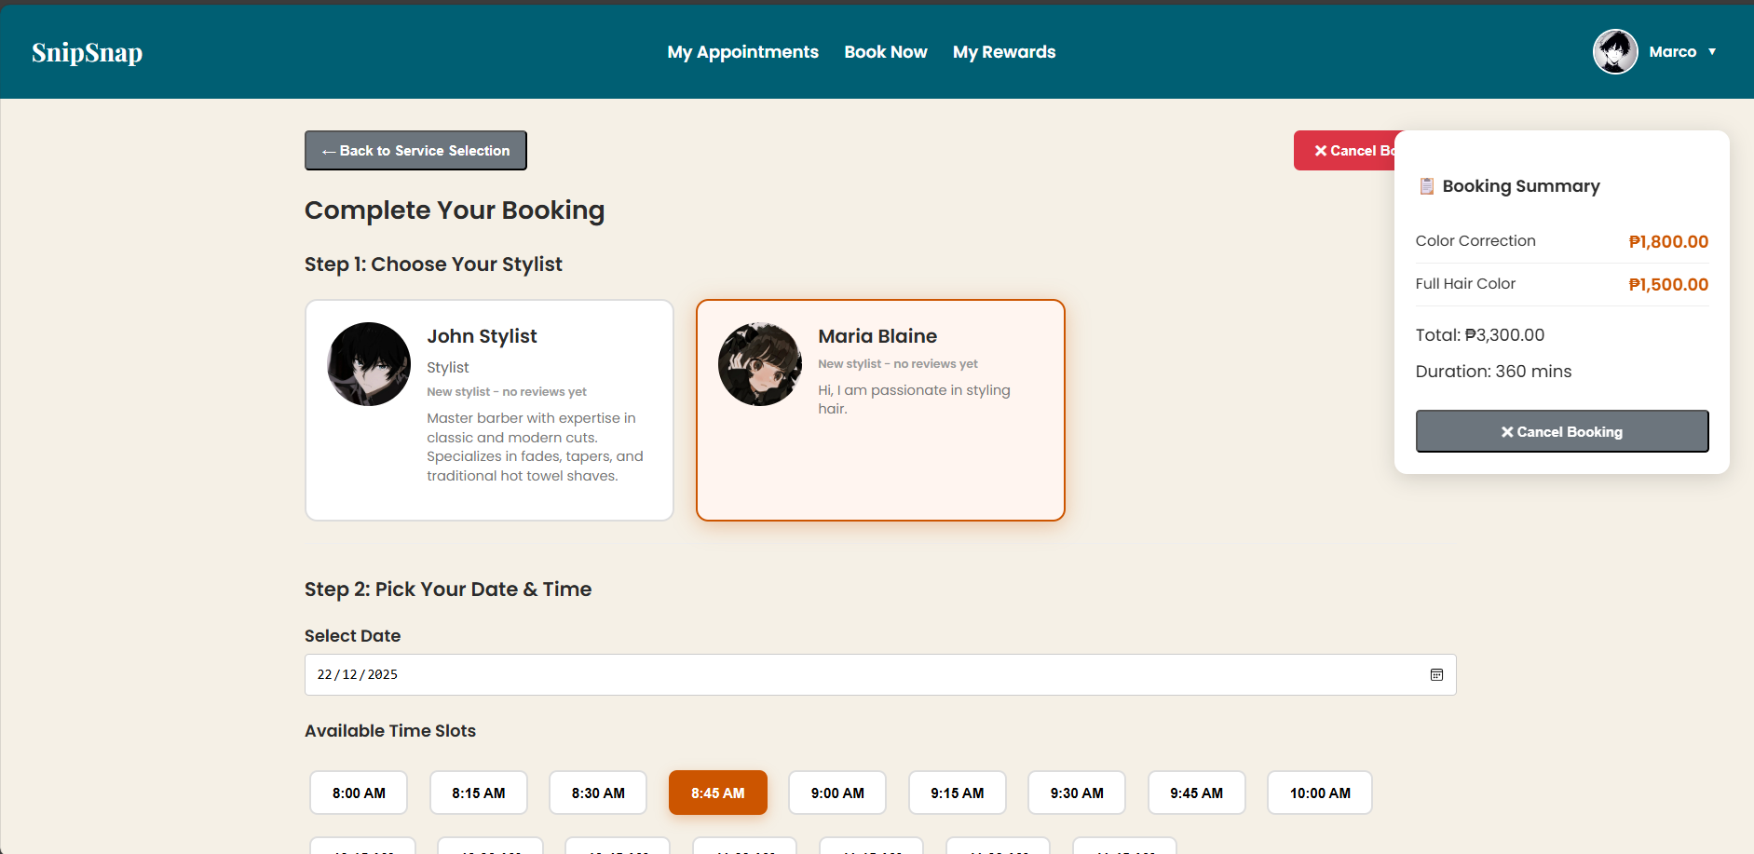
Booking Page 2

Slide 17
Booking Page 2

Slide 18
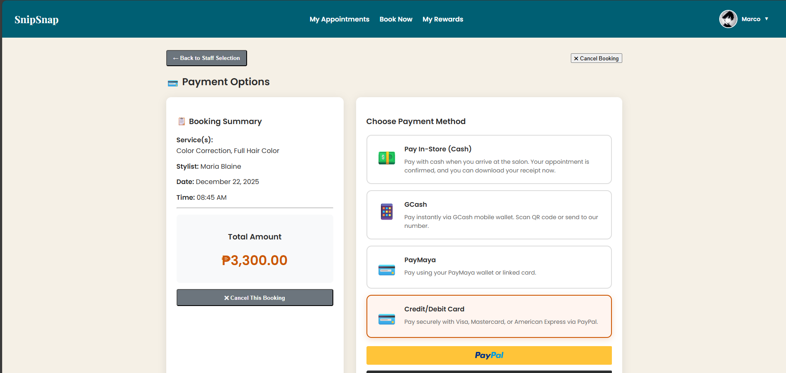
Payment Page

Slide 19
Payment Page

Slide 20
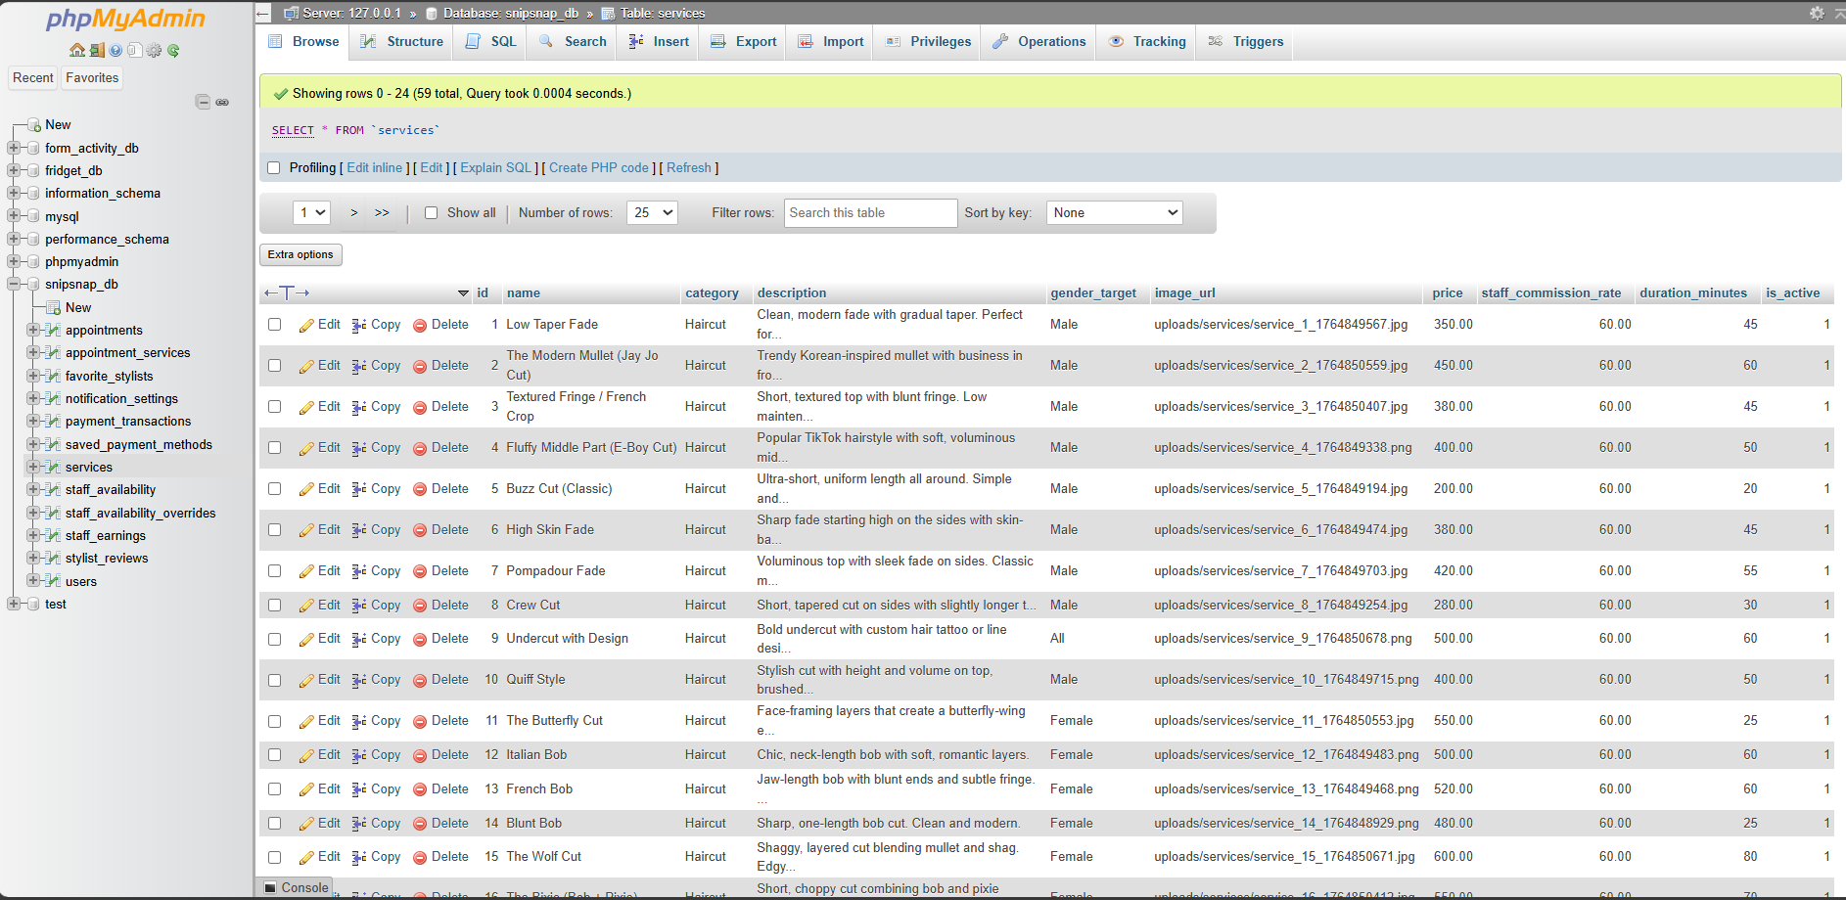
Database Services

Slide 21
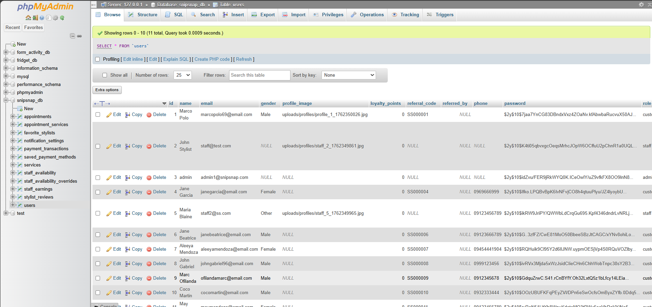
Database Users

Slide 22
Thank you for Listening!!!

